Slide 1
Formal Methods
By: Dr. Sarmad Sadik

Slide 2
Objectives
To introduce formal methods technique and multiple logic based approaches for software modelling and reasoning

Slide 3
Course Contents
Introduction to Formal Methods
Propositional Logic
First Order Predicate Logic
Pi-Calculus
Pi ADL
Z-Notation
Advanced Topics

Slide 4
Books
Text Book:
Logic in Computer Science by Michael Huth and Mark Ryan, Second Edition
A Calculus of Mobile Processes by Robin Milner
Reference Book:
Using Z: Specification, Refinement, and Proof, Oxford university Press by Woodcock, J.C.P. and Davies, J.
Discrete Mathematics with Examples by Simpson

Slide 5
Grading
Assignments/Project – 10%
Quizzes – 10%
OHTs– 15% + 15%
Final Exam – 50%

Slide 6
What are Formal Methods? (1/3)
Background- hard to
-Define requirements
-Anticipate change
-Accommodate new functionality
Why now
-Scientific theory: explain and predict
- Explain to users and developer; precise documentation
-Predict behavior of the software

Slide 7
What are Formal Methods? (2/3)
Formalism clarifies the problem, adds precision to the solution and enables analysis.

Slide 8
What are Formal Methods? (3/3)
Formal Methods use Formulas
Formula is a text or diagram constructed from predefined symbols combined according to explicit rules.
Formula is any thing whose appearance or syntax can be checked by a computer

Slide 9
Formal Methods in Software Development (1/3)
Formal methods can be applied at various points through the development process
Specification
Formal methods may be used to give a description of the system to be developed, at whatever level of detail desired.
This formal description can be used to guide further development activities
Additionally, it can be used to verify that the requirements for the system being developed have been completely and accurately specified

Slide 10
Formal Methods in Software Development (2/3)
Development
If the formal specification is in an operational semantics, the observed behavior of the concrete system can be compared with the behavior of the specification.
The operational commands of the specification may be amenable to direct translation into executable code.

Slide 11
Formal Methods in Software Development (3/3)
Verification
Once a formal specification has been developed, the specification may be used as the basis for proving properties of the specification

Slide 12
Why Use Formal Methods?
Programs are mathematical entities.
They are expressed in a formal language
They have a formal semantics
They can be treated as
mathematical theories

Slide 13
Why Use Formal Methods?
The practical reason is to produce “correct” software.
Producing “correct” software is difficult
Size of programs
Complexity of programs
Removes ambiguity
Helps in understanding the design
Enhances early error detection

Slide 14
Formal Specifications
Formal specifications is the key to Formal method.
Un-ambiguity
There should be only one interpretation of the specification.
Consistency
It should be satisfiable.
Completeness
All aspects of the system should be specified.
Verifiability
It should be possible to prove properties of the specification, including that the specification implements the requirements.

Slide 15
Formal Specifications
There are 3 types of Formal Specifications
Behavioral Specifications
Describe constraints on the behavior of the system.
Structural Specifications
Describe constraints on internal composition of the system.
Interaction Specifications
Describe constraints on the interactions between two or more subsystems.

Slide 16
Formal Specifications

Slide 17
Logic
Logic: the science of reasoning, proof , thinking or inference.
Logic allows us to analyze a piece of reasoning and determine whether it is correct or not.
Logic: To determine whether the reasoning is valid or invalid.

Slide 18
What is an Argument (1/6)
"An argument is a connected series of statements intended to establish a proposition".
(Michael Palin i Monty Python’s Argument Clinic.)

Slide 19
What is an Argument (2/6)
The building blocks of a logical argument are propositions, also called statements.
A proposition is a statement which is either true or false; for example:
"The first programmable computer was built
in Cambridge."
"Dogs cannot see color."

Slide 20
What is an Argument (3/6)
There are three stages to an argument:
Premises
Inference
Conclusion.
Premises
One or more propositions are necessary for the argument to continue. They must be stated explicitly. They are called the premises of the argument.
They are the evidence (or reasons) for accepting the argument and its conclusions.

Slide 21
What is an Argument? (4/6)
Inference
The premises of the argument are used to obtain further propositions. This process is known as inference.
In inference, we start with one or more propositions which have been accepted. We then derive a new proposition. There are various forms of valid inference.
The propositions arrived at by inference may then be used in further inference. Inference is often denoted by phrases such as implies that or therefore.

Slide 22
What is an Argument? (5/6)
Conclusion:
Finally, we arrive at the conclusion of the argument, another proposition. The conclusion is often stated as the final stage of inference. It is affirmed on the basis of the original premises, and the inference from them.
Conclusions are often indicated by phrases such as therefore, it follows that, we conclude and so on.

Slide 23
What is an Argument? (6/6)
An argument is thus a statement logically inferred from premises. Neither an opinion nor a belief can qualify as an argument!
Two sorts of arguments:
deductive
inductive
Deductive inferences:
general → particular
Inductive inferences:
particular → general

Slide 24
Deduction
A Deductive Argument is defined as
Constructed according to valid rules of inference
Conclusion necessarily follow from the premises
Valid:
All men are mortal.
Socrates is a man.
Therefore Socrates is mortal.
The picture is above the desk.
The desk is above the floor.
Therefore the picture is above the floor.

Slide 25
Deduction
Invalid:
Every criminal opposes the government.
Everyone in the opposition party opposes
the government.
Therefore everyone in the opposition party is a criminal.

Slide 26
Induction (1/2)
Induction is the process of reasoning in which the premises of an argument support the conclusion, but do not ensure it.
Valid:
All observed crows are black.
Therefore all crows are black.
Invalid:
I always hang pictures on nails.
Therefore all pictures are hung from nails.
Inductive Argument will never offer 100% certainty
A typical problem with inductive argument is that it is
formulated generally, while the observations are made
under specific conditions.

Slide 27
Induction (2/2)
An inductive argument have no way to logically (with certainty) prove that:
the phenomenon studied do exist in general domain
that it continues to behave according to the same pattern
Counter Example
Perhaps the most well known counter-example was the discovery of black swans in Australia. Prior to the point, it was assumed that all swans were white. With the discovery of the counter-example, the induction concerning the color of swans had to be re-modeled.

Slide 28
Mathematical Induction
The simplest and most common form of mathematical induction proves that a statement holds for all natural numbers n and consists of two steps:
The basis
showing that the statement holds when n = 0.
The inductive step
showing that if the statement holds for n = m, then the same statement also holds for n = m + 1
It may be helpful to think of the domino effect; if you have a long row of dominos standing on end and you can be sure that:
The first domino will fall.
Whenever a domino falls, its next neighbor will also fall.
Then you can conclude that all dominos will fall.

Slide 29
Induction VS Deduction Hypothetico-Deductive Method
Deduction and induction occur as a part of the common hypothetico-deductive method, which can be simplified in the following scheme:
Ask a question and formulate a hypothesis/educated guess ( induction)
Make predictions about the hypothesis (deduction).
Test the hypothesis (induction).

Slide 30
INDUCTION & DEDUCTION (1/2)
Deduction, if applied correctly, leads to true conclusions. But deduction itself is based on the fact that we know something for sure.
For example we know the general law which can be used to deduce some particular case, such as
“All humans are mortal. Socrates is human. Therefore is Socrates mortal.”
How do we know that all humans are mortal? How have we arrived to the general rule governing our deduction?
Again, there is no other method at hand but (empirical) induction.

Slide 31
INDUCTION & DEDUCTION (2/2)
In fact, the truth is even induction implies steps following deductive rules. On our way from specific (particular) up to universal (general) we use deductive reasoning. We collect the observations or experimental results and extract the common patterns or rules or regularities by deduction.
For example, in order to infer by induction the fact that all planets orbit the Sun, we have to analyze astronomical data using deductive reasoning.

Slide 32
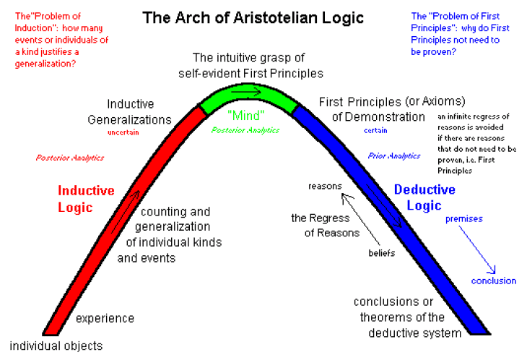
INDUCTION & DEDUCTION: Traditional View

Slide 33
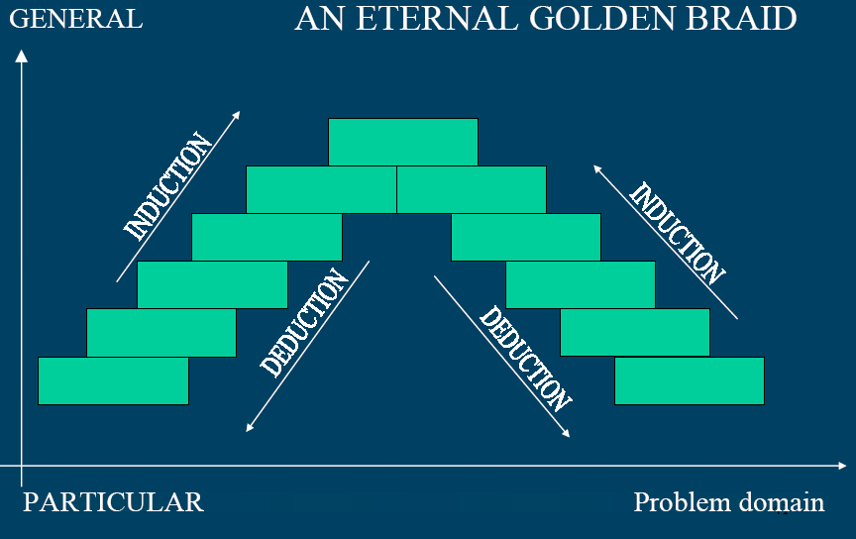
Induction Vs Deduction

Slide 34
FALLACIES
Two distinct categories are
Formal fallacy : wrong formal construction of an argument.
Informal fallacy : wrong inference or reasoning.

Slide 35
References
Martin Russell http://www.eee.bham.ac.uk/russellm/
J.A. Hall, Seven Myths of Formal Methods. IEEE Software, 7(5):11-19, September 1990.
Monty Python's Argument Clinic http://www.duke.edu/~pms5/humor/argument.html
Mathematics For Computer Science Spring 2005
http://ocw.mit.edu/OcwWeb/Electrical-Engineering-and-Computer-Science/6-042JSpring-2005/CourseHome/index.htm
http://www.cs.wm.edu/~coppit/csci435-spring2004/lectures/18-formal-methods-1.pdf

